Slide 1

SQL Training
April 2022

Slide 2
Example Queries

Slide 3
Sample Table
Table name: customer
Column names (important ones only):
gender
dayofbirth
monthofbirth
yearofbirth
customerid
creationdate

Slide 4
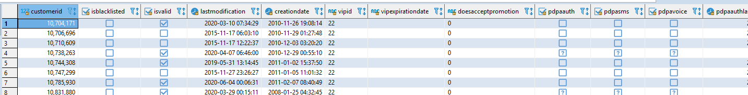
Queries – SELECT and LIMIT
Query:
select *
from customer
* = all columns
Query:
select *
from customer
limit 2

Slide 5
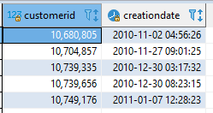
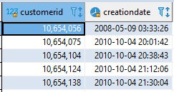
Queries – choosing columns and ordering
Query:
select customerid, creationdate
from customer
limit 5
Query:
select customerid, creationdate
from customer
order by customerid
limit 5

Slide 6
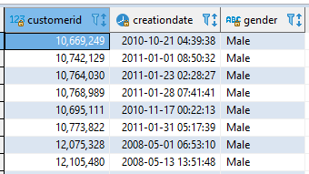
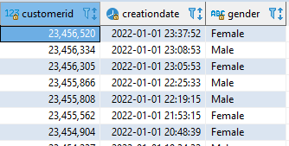
Queries – filtering and comparison operator
Query:
select customerid, creationdate, gender
from customer
where gender='Male'
Query:
select customerid, creationdate, gender
from customer
where creationdate>='2022-01-01'

Slide 7


Queries – aggregate functions, GROUP BY, and renaming columns
Query:
select count(customerid)
from customer
Available aggregate functions:
count
avg
max
min
sum
Query:
select gender, count(customerid) as total_by_gender
from customer
group by gender

Slide 8
Sample Table 2
Table name: basket
Column names (important ones only):
Column Name (important ones only) | Description
recordid | record of each sales transaction
customerid | id of customer that had purchased
productsales | purchase details with products, qty and $ value
ordertime | date and time of order

Slide 9
Queries – JOIN
customer table
basket table
customerid | gender
1 | Male
2 | Female
3 | Male
recordid | customerid
X1 | 1
X2 | 1
X3 | 2
X4 | 3
X5 | 3
We can use JOIN to connect the two tables – notice that both tables have the ‘customerid’ column and we can use that as the related column
Question:
Who orders more, male or female customers?

Slide 10

Queries – JOIN and aliases (nicknaming tables for easy reference)
Query:
select c.gender, count(distinct b.recordid) as number_of_orders
from customer c
join basket b on c.customerid=b.customerid
group by c.gender
order by number_of_orders desc
Types of JOIN:
Inner join: JOIN
Left join: LEFT OUTER JOIN
Right join: RIGHT OUTER JOIN
Full join: FULL OUTER JOIN
This query answers the question:
Who orders more, male or female customers?

Slide 11
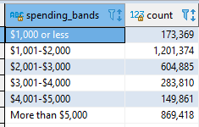
Queries – CASE … WHEN, nested queries, and referring to columns by its position (1, 2, 3, etc.)
Query:
select
case when spent>5000 then 'More than $5,000'
when spent>4000 then '$4,001-$5,000'
when spent>3000 then '$3,001-$4,000'
when spent>2000 then '$2,001-$3,000'
when spent>1000 then '$1,001-$2,000'
else '$1,000 or less' end as spending_bands, count(customerid)
from
(
select customerid, sum(productsales) as spent
from basket
group by 1
) spending_table
group by 1
order by 1
For group by and order by, we can instead use numbers to refer to columns based on its position in the table
In the example shown, we use group by 1 to tell SQL to group by the first column in the resulting table, that is customerid in the nested table and spending_bands in the final table
Same goes for order by 1 which means we want to get the final table sorted by the first column in the resulting table, that is spending_bands
This query answers the question:
How many customers spent 0-1000, 1000-2000, 2000-3000, 3000-4000, 4000-5000, and 5000+?

